Slide 1


Microprocessors and Assembly Language Spring 2020
Hamed Farbeh
farbeh@aut.ac.ir
Department of Computer Engineering
Amirkabir University of Technology
Lecture 9

Slide 2
Copyright Notice
Parts (text & figures) of this lecture are adopted from:
Atmel | SMART ARM-based MCU DATASHEET, SAM3X / SAM3A Series, Atmel-11057C-ATARM-SAM3X-SAM3A-Datasheet_23-Mar-15
http://www.circuitbasics.com/basics-uart-communication/
Microprocessors and Assembly Language, Spring 2020, AUT, Tehran, Iran

Slide 3

Universal Asynchronous Receiver/Transmitter (UART)
Microprocessors and Assembly Language, Spring 2020, AUT, Tehran, Iran

Slide 4
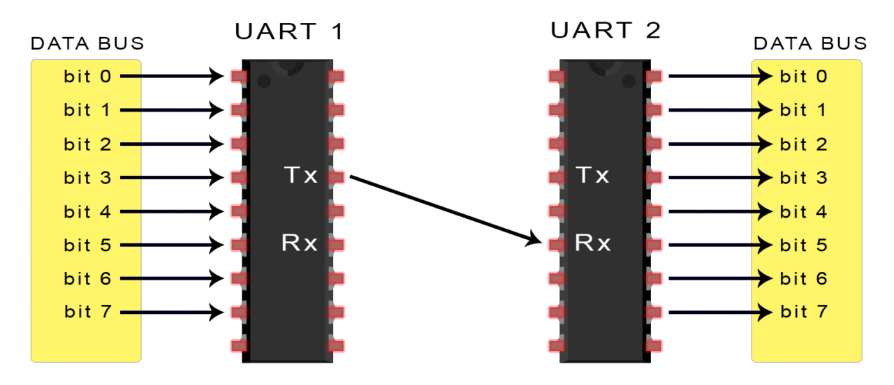
Basics of UART Communication
Asynchronous serial communication
Uses two wires to transmit data between devices
Data flows from the Tx pin of the transmitting UART
to the Rx pin of the receiving UART
No clock signal to synchronize the output of bits from the transmitting UART
to the sampling of bits by the receiving UART
http://www.circuitbasics.com/basics-uart-communication/
Microprocessors and Assembly Language, Spring 2020, AUT, Tehran, Iran

Slide 5
UART Communication Details
The transmitting UART adds start and stop bits
to the data packet being transferred
These bits define the beginning and end of the data packet
so the receiving UART knows when to start reading the bits
The receiving UART detects a start bit
Then, starts to read the incoming bits
at a specific frequency known as the baud rate
Baud rate: a measure of the speed of data transfer
expressed in bits per second (bps)
The baud rate between the transmitting and receiving UARTs can only differ by about 10%
http://www.circuitbasics.com/basics-uart-communication/
Microprocessors and Assembly Language, Spring 2020, AUT, Tehran, Iran

Slide 6
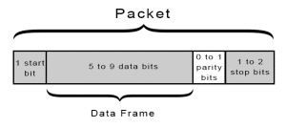
UART Communication Details
When not transmitting data
The UART transmission line is held at a high voltage level
START BIT
The transmitting UART pulls the line from high to low for one clock cycle
STOP BITS
The sending UART drives the data transmission line from a low voltage to a high voltage for at least two bit durations
http://www.circuitbasics.com/basics-uart-communication/
Microprocessors and Assembly Language, Spring 2020, AUT, Tehran, Iran

Slide 7
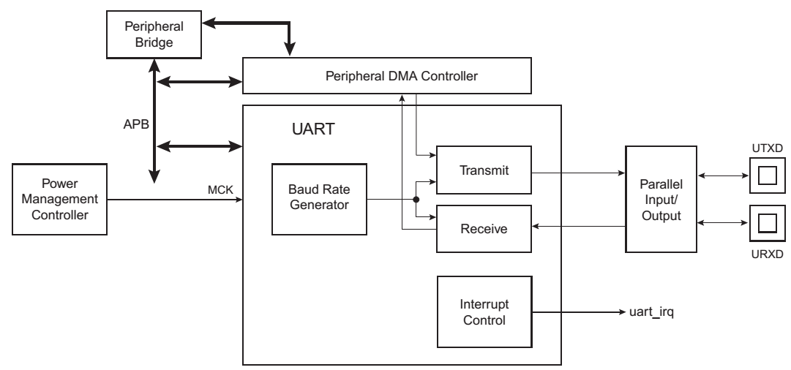
UART in SAM3X8E
Independent Receiver and Transmitter
with a Common Programmable Baud Rate Generator
Even, Odd, Mark or Space Parity Generation
Parity, Framing and Overrun Error Detection
Interrupt Generation
Ch. 34: Atmel | SMART ARM-based MCU DATASHEET, SAM3X / SAM3A Series, Atmel-11057C-ATARM-SAM3X-SAM3A-Datasheet_23-Mar-15
Microprocessors and Assembly Language, Spring 2020, AUT, Tehran, Iran

Slide 8
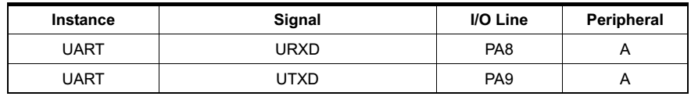
UART in SAM3X8E
The UART pins are multiplexed with PIO lines
The programmer must first configure the PMC to enable the UART clock
PMC: Power Management Controller
Only 8-bit character is supported (with parity)
Ch. 34: Atmel | SMART ARM-based MCU DATASHEET, SAM3X / SAM3A Series, Atmel-11057C-ATARM-SAM3X-SAM3A-Datasheet_23-Mar-15
Microprocessors and Assembly Language, Spring 2020, AUT, Tehran, Iran

Slide 9
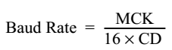
Baud Rate Generator in SAM3X8E
The baud rate clock
Is the master clock divided by 16 times the value (CD) written in UART_BRGR (Baud Rate Generator Register)
If UART_BRGR is set to 0, the baud rate clock is disabled and the UART remains inactive
The maximum allowable baud rate is Master Clock divided by 16
The minimum allowable baud rate is Master Clock divided by (16 x 65536)
Ch. 34: Atmel | SMART ARM-based MCU DATASHEET, SAM3X / SAM3A Series, Atmel-11057C-ATARM-SAM3X-SAM3A-Datasheet_23-Mar-15
Microprocessors and Assembly Language, Spring 2020, AUT, Tehran, Iran

Slide 10
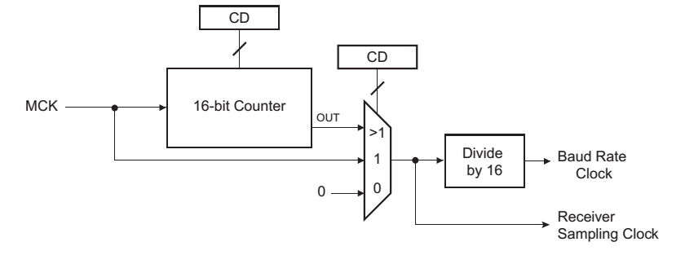
Baud Rate Generator in SAM3X8E
Ch. 34: Atmel | SMART ARM-based MCU DATASHEET, SAM3X / SAM3A Series, Atmel-11057C-ATARM-SAM3X-SAM3A-Datasheet_23-Mar-15
Microprocessors and Assembly Language, Spring 2020, AUT, Tehran, Iran

Slide 11
UART Receiver in SAM3X8E
Receiver Reset, Enable and Disable
After device reset, the UART receiver is disabled
To enable: RXEN = 1 in the control register (UART_CR)
If enabled: the receiver starts looking for a start bit
To disable: RXDIS = 1 in the control register (UART_CR)
If the receiver is waiting for a start bit, it is immediately stopped
If the receiver has already detected a start bit and is receiving the data, it waits for the stop bit before actually stopping its operation
To reset: RSTRX =1 in the control register (UART_CR)
The receiver immediately stops its current operations and is disabled, whatever its current state!
Ch. 34: Atmel | SMART ARM-based MCU DATASHEET, SAM3X / SAM3A Series, Atmel-11057C-ATARM-SAM3X-SAM3A-Datasheet_23-Mar-15
Microprocessors and Assembly Language, Spring 2020, AUT, Tehran, Iran

Slide 12
Start Detection and Data Sampling
A low level (space) on URXD is interpreted as a valid start bit
if it is detected for more than 7 cycles of the sampling clock
Sampling clock = 16 x baud rate
The receiver samples the URXD at the theoretical midpoint of each bit
When a valid start bit has been detected
It is assumed that each bit lasts 16 cycles of the sampling clock (1-bit period): the bit sampling point is eight cycles (0.5-bit period) after the start of the bit
The first sampling point is therefore 24 cycles (1.5-bit periods) after the falling edge of the start bit was detected
Each subsequent bit is sampled 16 cycles (1-bit period) after the previous one
Ch. 34: Atmel | SMART ARM-based MCU DATASHEET, SAM3X / SAM3A Series, Atmel-11057C-ATARM-SAM3X-SAM3A-Datasheet_23-Mar-15
Microprocessors and Assembly Language, Spring 2020, AUT, Tehran, Iran

Slide 13
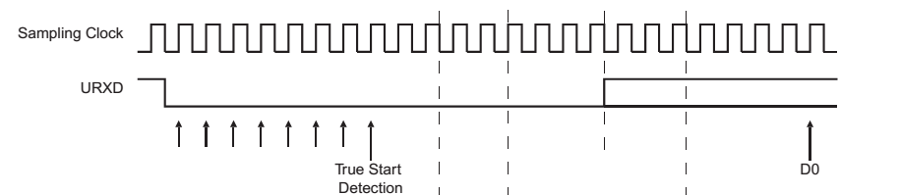
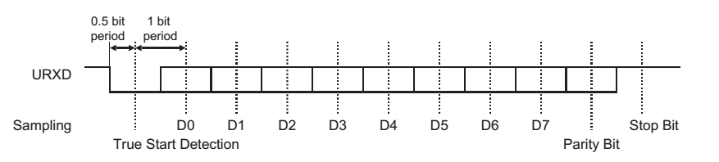
Start Detection and Data Sampling
Ch. 34: Atmel | SMART ARM-based MCU DATASHEET, SAM3X / SAM3A Series, Atmel-11057C-ATARM-SAM3X-SAM3A-Datasheet_23-Mar-15
Microprocessors and Assembly Language, Spring 2020, AUT, Tehran, Iran

Slide 14
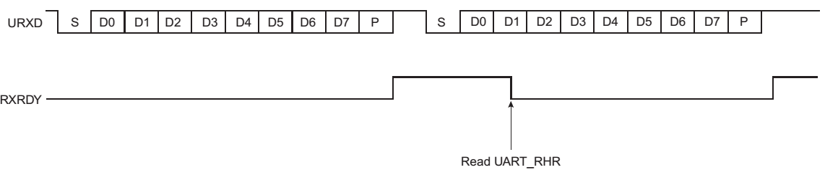
Receiver Ready
When a complete character is received
Is transferred to the receive holding register (UART_RHR )
The RXRDY status bit in UART_SR (Status Register) is set
The bit RXRDY is automatically cleared when the UART_RHR is read
Ch. 34: Atmel | SMART ARM-based MCU DATASHEET, SAM3X / SAM3A Series, Atmel-11057C-ATARM-SAM3X-SAM3A-Datasheet_23-Mar-15
Microprocessors and Assembly Language, Spring 2020, AUT, Tehran, Iran

Slide 15
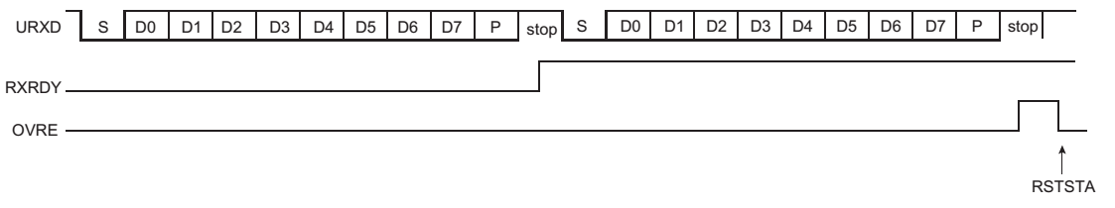
Receiver Overrun
If UART_RHR has not been read by the software (or the Peripheral Data Controller or DMA Controller) since the last transfer
and a new character is received
the OVRE status bit in UART_SR is set
OVRE is cleared when the software writes the control register UART_CR with the bit RSTSTA (Reset Status) at 1
Ch. 34: Atmel | SMART ARM-based MCU DATASHEET, SAM3X / SAM3A Series, Atmel-11057C-ATARM-SAM3X-SAM3A-Datasheet_23-Mar-15
Microprocessors and Assembly Language, Spring 2020, AUT, Tehran, Iran

Slide 16
Transmitter
The UART transmitter is disabled after device reset
To enable: TXEN = 1 in the control register UART_CR
The transmitter waits for a character to be written in the Transmit Holding Register (UART_THR) before actually starting the transmission
To disable: TXDIS = 1 in the control register UART_CR
If the transmitter is not operating, it is immediately stopped
If a character is being processed into the Shift Register and/or a character has been written in the Transmit Holding Register, the characters are completed before the transmitter is stopped
To reset: RSTTX = 1 in the UART_CR
Ch. 34: Atmel | SMART ARM-based MCU DATASHEET, SAM3X / SAM3A Series, Atmel-11057C-ATARM-SAM3X-SAM3A-Datasheet_23-Mar-15
Microprocessors and Assembly Language, Spring 2020, AUT, Tehran, Iran

Slide 17
Transmitter Control
When enabled, the bit TXRDY is set in the UART_SR
The transmission starts when
The programmer writes in the UART_THR and
The written character is transferred from UART_THR to the Shift Register
The TXRDY bit remains high until a second character is written in UART_THR
As soon as the first character is completed
The last character written in UART_THR is transferred into the shift register and TXRDY rises again
Showing that the holding register is empty
When both the Shift Register and UART_THR are empty
All the characters written in UART_THR have been processed
The TXEMPTY bit rises after the last stop bit has been completed
Ch. 34: Atmel | SMART ARM-based MCU DATASHEET, SAM3X / SAM3A Series, Atmel-11057C-ATARM-SAM3X-SAM3A-Datasheet_23-Mar-15
Microprocessors and Assembly Language, Spring 2020, AUT, Tehran, Iran

Slide 18
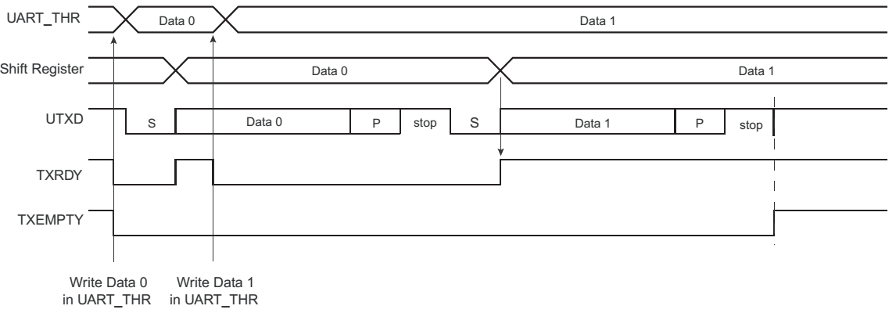
Transmitter Control
Ch. 34: Atmel | SMART ARM-based MCU DATASHEET, SAM3X / SAM3A Series, Atmel-11057C-ATARM-SAM3X-SAM3A-Datasheet_23-Mar-15
Microprocessors and Assembly Language, Spring 2020, AUT, Tehran, Iran

Slide 19
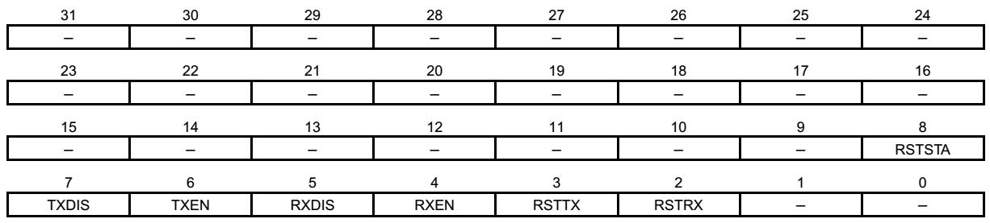
UART Registers
UART Control Register: UART_CR
RSTRX: Reset Receiver
RSTTX: Reset Transmitter
RXEN: Receiver Enable
RXDIS: Receiver Disable
TXEN: Transmitter Enable
TXDIS: Transmitter Disable
RSTSTA: Reset Status Bits (Resets the status bits PARE, FRAME and OVRE in the UART_SR)
Ch. 34: Atmel | SMART ARM-based MCU DATASHEET, SAM3X / SAM3A Series, Atmel-11057C-ATARM-SAM3X-SAM3A-Datasheet_23-Mar-15
Microprocessors and Assembly Language, Spring 2020, AUT, Tehran, Iran

Slide 20
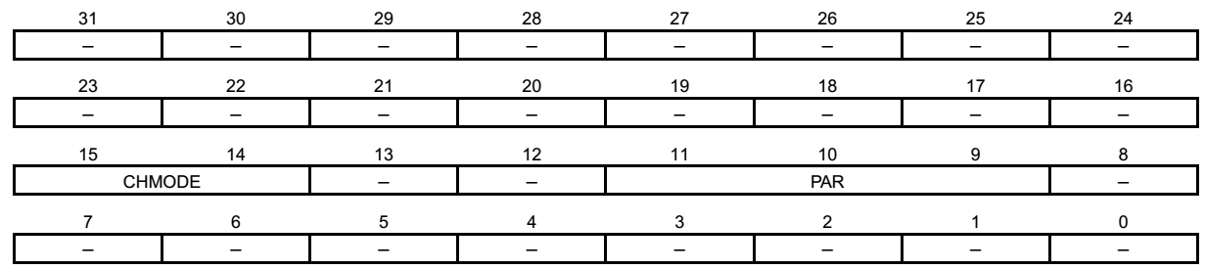
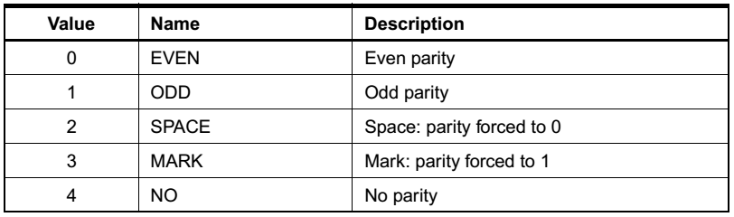
UART Registers
UART Mode Register: UART_MR
Ch. 34: Atmel | SMART ARM-based MCU DATASHEET, SAM3X / SAM3A Series, Atmel-11057C-ATARM-SAM3X-SAM3A-Datasheet_23-Mar-15
Microprocessors and Assembly Language, Spring 2020, AUT, Tehran, Iran

Slide 21
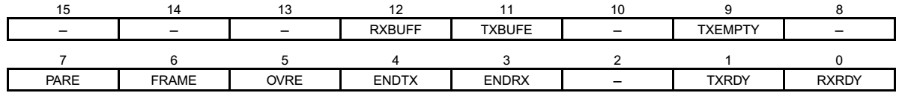
UART Registers
UART Interrupt Enable Register: UART_IER
RXRDY: Enable RXRDY Interrupt
TXRDY: Enable TXRDY Interrupt
ENDRX: Enable End of Receive Transfer Interrupt
ENDTX: Enable End of Transmit Interrupt
OVRE: Enable Overrun Error Interrupt
FRAME: Enable Framing Error Interrupt
PARE: Enable Parity Error Interrupt
TXEMPTY: Enable TXEMPTY Interrupt
TXBUFE: Enable Buffer Empty Interrupt
RXBUFF: Enable Buffer Full Interrupt
UART Interrupt Disable Register UART Interrupt Mask Register
UART Status Register
Ch. 34: Atmel | SMART ARM-based MCU DATASHEET, SAM3X / SAM3A Series, Atmel-11057C-ATARM-SAM3X-SAM3A-Datasheet_23-Mar-15
Microprocessors and Assembly Language, Spring 2020, AUT, Tehran, Iran

Slide 22
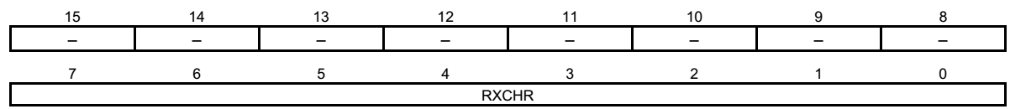
UART Registers
UART Receiver Holding Register: UART_RHR
Read-only
RXCHR: Received Character
Last received character if RXRDY is set
UART Transmit Holding Register: UART_THR
Write-only
TXCHR: Character to be Transmitted
Next character to be transmitted after the current character if TXRDY is not set
Ch. 34: Atmel | SMART ARM-based MCU DATASHEET, SAM3X / SAM3A Series, Atmel-11057C-ATARM-SAM3X-SAM3A-Datasheet_23-Mar-15
Microprocessors and Assembly Language, Spring 2020, AUT, Tehran, Iran

Slide 23
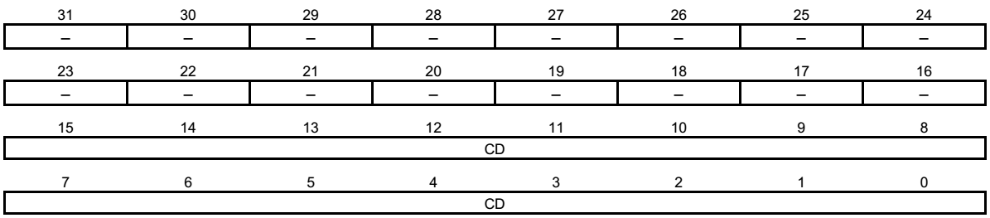
UART Registers
UART Baud Rate Generator Register: UART_BRGR
CD: Clock Divisor
0 = Baud Rate Clock is disabled
1 to 65,535 = MCK / (CD x 16)
Ch. 34: Atmel | SMART ARM-based MCU DATASHEET, SAM3X / SAM3A Series, Atmel-11057C-ATARM-SAM3X-SAM3A-Datasheet_23-Mar-15
Microprocessors and Assembly Language, Spring 2020, AUT, Tehran, Iran

Slide 24
The End (for now)!
Microprocessors and Assembly Language, Spring 2020, AUT, Tehran, Iran

